Slide 1
The Institute of Strategic Management of Nigeria Chartered, Rivers State Chapter STRATEGIC MANAGEMENT ESSENTIALS PROGRAM
Topic: Strategic Management: From TheorY to Practice
SPEAKER: SYLVA WARIBUGO
BSc. (First Class Honours) in MGT; MBA; MSc.; Ph.D
ASSOCIATE PROFESSOR
Department of Management, Faculty of Management Sciences,
University of Port Harcourt, Rivers State, Nigeria.
GSM number: 08033103959
DATE/TIME: Wednesday 7th May, 2025 │ 7.30pm to 9.30pm

Slide 2
BIO OF SPEAKER
Dr. Waribugo Sylva is an Associate Professor in the Department of Management, University of Port Harcourt. Sylva holds a Doctorate degree in Management in the University of Port Harcourt; with specialization in Production and Operations Management. He is the Acting Director of the University of Port Harcourt Entrepreneurship Centre, and a member of the University of Port Harcourt Hall of Fame.
Dr. Sylva is also an Adjunct Lecturer in the Federal University Otuoke and a Visiting Lecturer in the Garden City Premier Business School. He is an organisational physician, systems expert and performance coach who deploys both qualitative and quantitative approaches to address real-life problem situations.
Dr. Sylva is a recipient of the Charles Nwanoke’s prize for Overall Best Graduating Student in the University of Port Harcourt, with a GCPA of 4.78 (First Class Honours). He is a fellow of The Institute of Public Management (IPM) and The Institute of Chartered Economists of Nigeria (ICEN). He is also a member of many professional bodies such as the Production and Operations Management Society, USA; The Institute of Strategic Management, Nigeria; and the Academy of Management, Nigeria, among others. Dr. Sylva is a certified management consultant and has successfully conducted several impactful trainings for organisations in public and private sectors.
Dr. Sylva has attended and participated in international and local conferences/seminars, while most of his research articles have been published in referred journals, both locally and internationally. He was also the Executive Chairman of Nembe Local Government Council of Bayelsa State. He is married and has four children.

Slide 3
COURSE CONTENT
The foundations of strategic management and its significance.
How to craft and implement effective strategies at business and corporate levels.
Tools for internal and external environmental analysis.
Techniques to align organizational capabilities with strategic objectives.
The role of leadership and culture in strategy execution.
Methods for monitoring and controlling strategic initiatives.

Slide 4
OPENING QUOTES
“Victorious warriors win first and then go to war, while defeated warriors go to war first and then seek to win.”
“Strategy without tactics is the slowest route to victory. Tactics without strategy is noise before defeat”
— Sun Tzu, Chinese philosopher and military strategist

Slide 5
OPENING QUOTES
“If you don’t have a strategy, you are part of someone else's strategy.”
- Alvin Toﬄer

Slide 6
foundations of strategic management and its significance.
What is Strategic Management?
Strategic management involves the formulation and implementation of major goals and initiatives.
It aligns the organization’s mission, vision, and resources with external opportunities and threats.
It's essential for long-term success and sustainability.

Slide 7
foundations of strategic management and its significance.
Strategic Management Process
Define Vision & Mission
Analyze Internal and External Environments (SWOT, PESTEL)
Set Objectives
Formulate Strategy
Implement Strategy
Monitor and Evaluate

Slide 8
foundations of strategic management and its significance.
Levels of Strategy
Corporate-Level Strategy: Crafts overall vison and sets direction
Business-Level Strategy: Determines Competitive positioning
Functional-Level Strategy: Supports specific departmental goals/actions using expertise.
Operational-Level Strategy: Determines how daily routines should be carried out

Slide 9
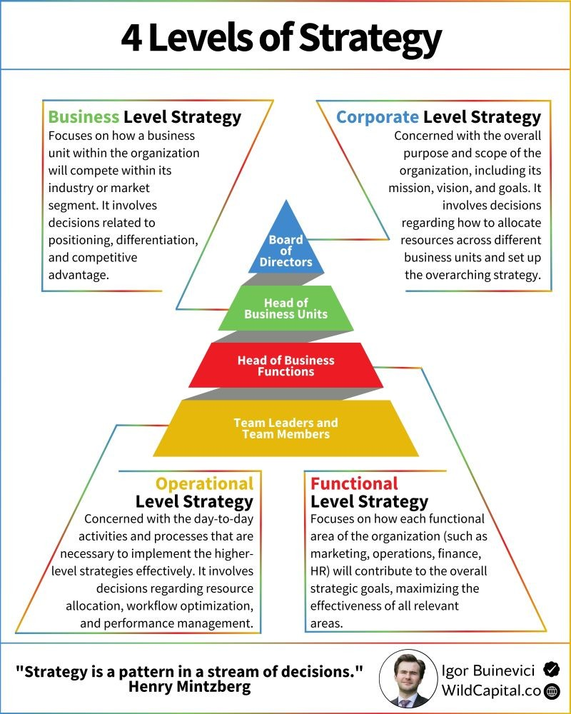
foundations of strategic management and its significance.

Slide 10
foundations of strategic management and its significance.
Strategic Tools
SWOT Analysis
PESTEL Analysis
Porter’s Five Forces
Value Chain Analysis
BCG Matrix

Slide 11
foundations of strategic management and its significance.

Slide 12
foundations of strategic management and its significance.
Example - SWOT Analysis for a Bank
STRENGTHS (INTERNAL, POSITIVE FACTORS)
Strong Brand Reputation – Established trust and recognition among customers.
Extensive Branch Network – Broad physical presence for customer accessibility.
Diversified Services – Offering retail banking, corporate banking, loans, investment services, etc.
Technology Infrastructure – Advanced digital platforms for online and mobile banking.
Regulatory Compliance – Strong track record of meeting financial regulations.
Skilled Workforce – Trained professionals in finance, risk, and customer service.

Slide 13
foundations of strategic management and its significance.
Example - SWOT Analysis for a Bank
WEAKNESSES (INTERNAL, NEGATIVE FACTORS)
Weaknesses (Internal, Negative Factors)
Legacy Systems – Dependence on outdated IT systems that hinder innovation.
High Operational Costs – Expenses tied to physical branches and administrative overhead.
Risk Exposure – Vulnerability to loan defaults and credit risks.
Slow Innovation Cycle – Lagging behind fintechs in adapting to new tech trends.
Customer Service Issues – Complaints about responsiveness or service quality.

Slide 14
foundations of strategic management and its significance.
Example - SWOT Analysis for a Bank
OPPORTUNITIES (EXTERNAL, POSITIVE FACTORS)
Digital Transformation – Growth potential through fintech partnerships and mobile banking.
Financial Inclusion – Expanding services to unbanked and underbanked populations.
Green Banking – Financing sustainable and eco-friendly projects.
Economic Growth – Rising middle class and SMEs needing banking services.
Cross-border Services – Expansion into regional or international markets.

Slide 15
foundations of strategic management and its significance.
Example - SWOT Analysis for a Bank
THREATS (EXTERNAL, NEGATIVE FACTORS)
Cybersecurity Risks – Threats from hacking, phishing, and data breaches.
Regulatory Changes – New laws or capital requirements that impact operations.
Fintech Disruption – Competition from agile, tech-driven financial startups.
Economic Instability – Inflation, currency devaluation, or recession risks.
Interest Rate Fluctuations – Impacting lending and borrowing behavior.

Slide 16
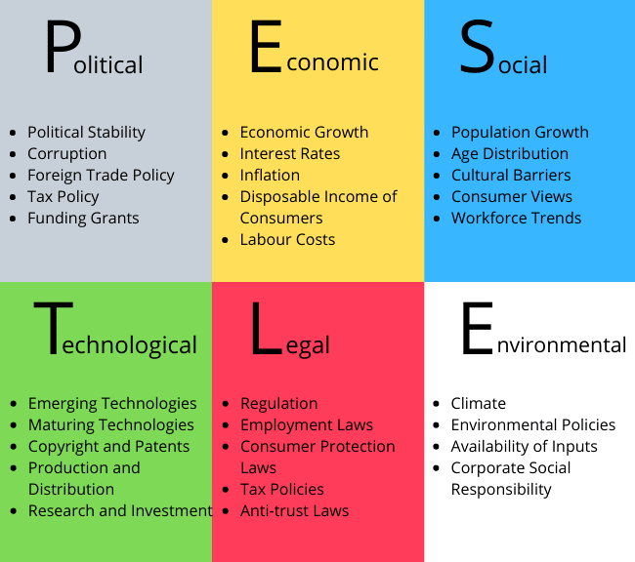
foundations of strategic management and its significance.

Slide 17
foundations of strategic management and its significance.
PESTEL analysis tailored for a smallholder farm
P – POLITICAL
Agricultural Policies: Government subsidies, support programs, or taxes can influence input costs and profitability.
Political Stability: Unrest can disrupt supply chains, transportation, or market access.
Trade Regulations: Tariffs or bans on agricultural exports/imports can affect input availability and product pricing.

Slide 18
foundations of strategic management and its significance.
PESTEL analysis tailored for a smallholder farm
E – ECONOMIC
Access to Credit: Availability of microloans or rural financing affects investment in seeds, tools, and fertilizers.
Inflation & Interest Rates: Affect the cost of inputs and ability to plan long-term.
Market Prices: Volatility in crop prices directly impacts income.
Labour Costs: Availability and cost of local labor, particularly during planting and harvest seasons.

Slide 19
foundations of strategic management and its significance.
PESTEL analysis tailored for a smallholder farm
S – SOCIAL
Demographics: Ageing farmers or youth migration to urban areas may reduce farm labor availability.
Education & Training: Limited access to agricultural extension services can hinder adoption of modern practices.
Food Preferences: Changes in consumer demand (e.g., organic, local food) may influence crop choice.
Cultural Practices: Traditional methods may resist mechanization or innovation.

Slide 20
foundations of strategic management and its significance.
PESTEL analysis tailored for a smallholder farm
T – TECHNOLOGICAL
Access to Tools & Machinery: Mechanization can improve efficiency but may be costly.
Irrigation Technology: Enhances resilience to climate variability.
Mobile Technology: Use of mobile apps for weather forecasts, market prices, or agronomic advice.
Storage & Processing Tech: Reduces post-harvest losses and increases value.

Slide 21
foundations of strategic management and its significance.
PESTEL analysis tailored for a smallholder farm
T – TECHNOLOGICAL
Access to Tools & Machinery: Mechanization can improve efficiency but may be costly.
Irrigation Technology: Enhances resilience to climate variability.
Mobile Technology: Use of mobile apps for weather forecasts, market prices, or agronomic advice.
Storage & Processing Tech: Reduces post-harvest losses and increases value.

Slide 22
foundations of strategic management and its significance.
PESTEL analysis tailored for a smallholder farm
E – ENVIRONMENTAL
Climate Change: Alters rainfall patterns, increases droughts/floods, affects crop viability.
Soil Degradation: Poor practices lead to erosion, nutrient loss.
Pest & Disease Outbreaks: Increased risks due to changing environmental conditions.
Water Availability: Scarcity affects irrigation and crop yield.

Slide 23
foundations of strategic management and its significance.
PESTEL analysis tailored for a smallholder farm
L – LEGAL
Land Use Regulations: Zoning laws or environmental restrictions can affect farm operations.
Health & Safety Regulations: Especially relevant if farm sells produce directly to consumers.
Labor Laws: Compliance with minimum wage, working conditions, etc.
Pesticide/Herbicide Regulations: Limits on chemical use to protect public health and ecosystems.

Slide 24
foundations of strategic management and its significance.
Challenges in Strategic Management
Uncertainty and change
Global competition
Technological disruptions
Resistance to change

Slide 25
foundations of strategic management and its significance.
Significance of Strategic Management
Provides direction and purpose
Enhances organizational performance
Promotes proactive management
Encourages long-term planning

Slide 26
foundations of strategic management and its significance.
Conclusion
Strategic management is vital for navigating complex environments.
It requires continuous learning and adaptation.
Effective strategy bridges the gap between vision and reality.

Slide 27
How to craft and implement effective strategies at business and corporate levels.
What is Strategy?
The determination of the basic long-term goals and objectives of an enterprise, and the adoption of courses of action and the allocation of resources necessary for carrying out these goals. - Alfred D. Chandler
The direction and scope of an organization over the long term, which achieves advantage in a changing environment through its configuration of resources and competences. - Johnson, Scholes & Whittington (2008).

Slide 28
How to craft and implement effective strategies at business and corporate levels.
Importance of Strategy in Achieving Organizational Goals
Provides Direction and Focus: Offers a clear roadmap for where the organization is heading; Aligns day-to-day decisions with long-term objectives.
Facilitates Resource Allocation: Ensures optimal use of limited resources (financial, human, technological). Avoids waste and duplication by focusing efforts on strategic priorities.

Slide 29
How to craft and implement effective strategies at business and corporate levels.
Importance of Strategy in Achieving Organizational Goals
Enhances Competitive Advantage: Helps an organization understand its environment and position itself to outperform competitors. Encourages innovation and differentiation.
Coordinates Organizational Activities: Unifies departments and teams toward shared objectives. Encourages cross-functional collaboration and coherence.

Slide 30
How to craft and implement effective strategies at business and corporate levels.
Importance of Strategy in Achieving Organizational Goals
Enables Proactive Management: Anticipates and prepares for changes in market, technology, and regulation. Encourages agility and responsiveness in a dynamic environment.
Drives Long-Term Sustainability: Fosters consistent growth and adaptability. Balances short-term performance with long-term vision.
Improves Decision-Making: Strategy serves as a decision-making framework under uncertainty. Prioritizes actions based on alignment with strategic goals.

Slide 31
How to craft and implement effective strategies at business and corporate levels.
Corporate Level Strategy
This involves overarching strategic decisions made by the top management of an organization that determine the overall scope and direction of the company across its various businesses or divisions.
Purpose: To maximize long-term profitability and sustainability by choosing the right mix of businesses and managing them in a way that adds value beyond what they could achieve individually.

Slide 32
How to craft and implement effective strategies at business and corporate levels.
Key Elements of Corporate Level Strategy
Business Portfolio Decisions: Which industries or markets should the company compete in? Should the company diversify, acquire, merge, or divest?
Resource Allocation: How should resources (capital, talent, etc.) be distributed among different business units?
Value Creation: How can synergy be created between different businesses to enhance overall performance?
Growth Orientation: Pursuing organic growth, acquisitions, or international expansion.
Risk Management: Spreading risk across different industries or regions.

Slide 33
How to craft and implement effective strategies at business and corporate levels.
Types of Corporate Level Strategies
. Growth Strategy: Focuses on expanding the company's activities and market presence.
(i) Concentration: Focus on a single business or market (e.g., Coca-Cola focusing on beverages).
(ii) Diversification: Entering new industries or markets.
(iii) Related Diversification: Entering a similar or complementary industry.
(iv) Unrelated Diversification: Entering a completely different industry.

Slide 34
How to craft and implement effective strategies at business and corporate levels.
Types of Corporate Level Strategies
Stability Strategy: Aims to maintain the current business status and performance.
Suitable for mature businesses with stable environments.
Focuses on incremental improvements and efficiency.
Often chosen when the external environment is unpredictable or when risk needs to be minimized.

Slide 35
How to craft and implement effective strategies at business and corporate levels.
Types of Corporate Level Strategies
Retrenchment Strategy: Used when a company is facing challenges and needs to reduce scope or restructure.
Turnaround: Reorganizing operations to become profitable again.
Divestiture: Selling off parts of the business.
Liquidation: Closing down unprofitable units or the entire business.
Combination Strategy: Uses different strategies for different parts of the business simultaneously. For example, a company might grow its tech unit while divesting a struggling retail arm.

Slide 36
How to craft and implement effective strategies at business and corporate levels.
How to Craft Corporate Level Strategies
Define Vision, Mission & Core Values: Set long-term direction and purpose. Ensure alignment with stakeholder expectations.
Conduct Portfolio Analysis: Use tools like BCG Matrix or GE/McKinsey Matrix. Evaluate each business unit's performance and market attractiveness.
Identify Growth Opportunities: Options include diversification (related/unrelated), acquisitions, alliances, or divestitures.
Set Strategic Objectives: Define goals for profitability, growth, and synergy among business units.

Slide 37
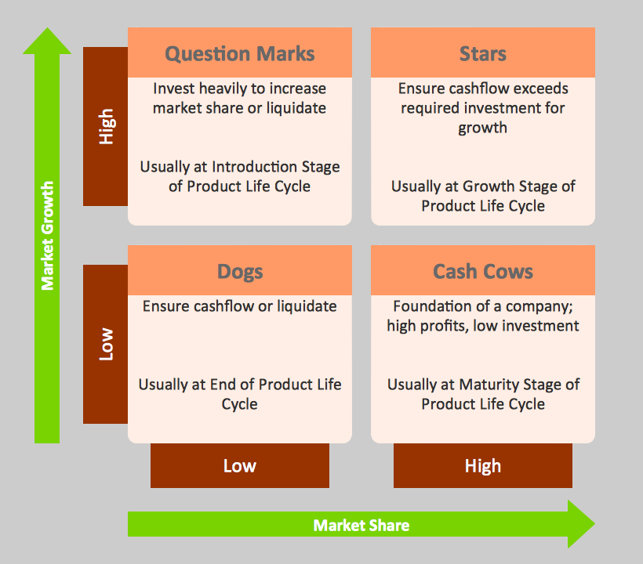
How to craft and implement effective strategies at business and corporate levels.
Example – the Boston Consulting Group (BCG) Matrix for Implementation of Strategy

Slide 38
How to craft and implement effective strategies at business and corporate levels.
Example – BCG Matrix for Implementation of Strategy in the Banking Sector
Stars (High Market Share, High Growth): These are business units with a strong competitive position in a fast-growing market.
Examples for Banks: Digital/Online Banking platforms, Mobile payment services, Fintech partnerships
Strategy: Invest heavily to maintain/expand market share; Innovate to stay ahead in digital offerings; Expand infrastructure (e.g., cloud, cybersecurity)

Slide 39
How to craft and implement effective strategies at business and corporate levels.
Example – BCG Matrix for Implementation of Strategy in the Banking Sector
Cash Cows (High Market Share, Low Growth): These are stable, profitable business units that generate more cash than they consume.
Examples for Banks: Retail banking; Corporate banking; ATM networks.
Strategy: Maximize cash flow; Improve operational efficiency; Use profits to fund Stars and Question Marks

Slide 40
How to craft and implement effective strategies at business and corporate levels.
Example – BCG Matrix for Implementation of Strategy in the Banking Sector
Question Marks (Low Market Share, High Growth): These are business units in high-growth markets but with a weak position.
Examples for Banks: Cryptocurrency or blockchain-related services; Green financing or ESG (based on borrower's commitment to sustainability - Environmental, Social and Governance) lending; AI-driven customer support
Strategy: Analyze whether to invest heavily to grow or divest; Pilot programs to test viability; Form alliances or partnerships

Slide 41
How to craft and implement effective strategies at business and corporate levels.
Example – BCG Matrix for Implementation of Strategy in the Banking Sector
Dogs (Low Market Share, Low Growth): These are underperforming services with low market potential.
Examples for Banks: Outdated manual services; Legacy branches in low-footfall areas.
Strategy: Divest or phase out; Reduce investment; Reallocate resources to more promising areas

Slide 42
How to craft and implement effective strategies at business and corporate levels.
Implementation Benefits of BCG Matrix for Banks
Resource Allocation: Prioritize funding and human resources effectively.
Strategic Focus: Concentrate on high-potential growth areas.
Risk Management: Avoid over-investing in low-potential areas.
Innovation Planning: Recognize where transformation is needed.

Slide 43
How to craft and implement effective strategies at business and corporate levels.
How to Implement Corporate Level Strategies
Allocate Resources Strategically: Fund high-potential business units or emerging opportunities.
Develop Corporate Governance Systems: Clarify roles of the corporate center vs. business units.
Manage Change and Culture: Create buy-in through communication and leadership.
Monitor and Control: Use KPIs and regular reviews to track progress and make adjustments.

Slide 44
How to craft and implement effective strategies at business and corporate levels.
Business Level Strategies
Business-Level Strategies are the plans and actions a company adopts to compete effectively in a particular market or industry.
Focus on how a business unit (within a larger corporation or independently) can achieve competitive advantage and satisfy customers better than its rivals.
Main goal: To create value for customers and gain a sustainable competitive advantage in a specific market.

Slide 45
How to craft and implement effective strategies at business and corporate levels.
Key Components of a Business Level Strategy
Target Market Scope: Broad or narrow.
Source of Competitive Advantage: Cost leadership vs. Differentiation.
Customer Needs: Understanding and fulfilling specific market demands.

Slide 46
How to craft and implement effective strategies at business and corporate levels.
Types of Business Level Strategy
Cost Leadership
Aim: Become the lowest-cost producer in the industry.
How: Efficient operations, economies of scale, tight cost control.
Example: Access Bank, First Bank, Union Bank.
Differentiation
Aim: Offer products/services that are unique and valued by customers.
How: Superior quality, brand image, innovation, or customer service.
Example: GTBank, UBA, Stanbic IBTC.

Slide 47
How to craft and implement effective strategies at business and corporate levels.
Types of Business Level Strategies
Focus Strategy (Niche Market Strategy): Focuses on serving a specific market segment better than competitors - rather than targeting the whole market.
Cost Focus: Example: Heritage Bank - Targets agricultural value chains and the Nigerian diaspora, offering low-cost remittance and sector-specific loan products.
Differentiation Focus: Unique products for a niche market. Example: Rolls-Royce (luxury automobiles).
Hybrid or Transitional Strategies: blend elements of cost leadership and differentiation, or are in the process of shifting from one strategy to another.
Example: Zenith Bank, Sterling, Polaris, Unity

Slide 48
How to craft and implement effective strategies at business and corporate levels.
Types of Business Level Strategies
Hybrid or Transitional Strategies:
Zenith Bank: Known for operational efficiency and strong financial performance, but also invests in high-end digital platforms and excellent corporate services.
Sterling: Transitioning from niche retail and ethical banking to tech-driven, innovative banking (e.g., “OneBank” and environmental sustainability).
Unity: Targets agribusiness and rural sectors with low-cost strategies, while exploring digital transformation.

Slide 49
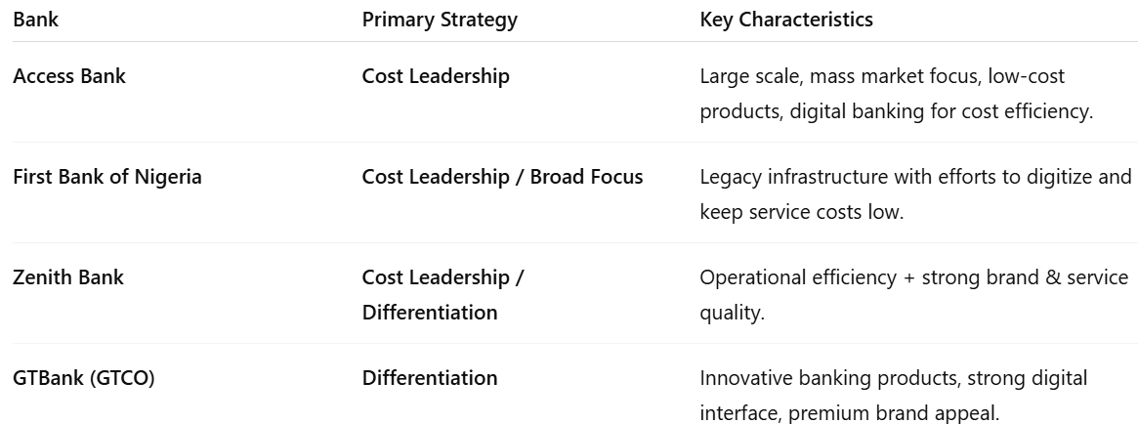
How to craft and implement effective strategies at business and corporate levels.

Slide 50
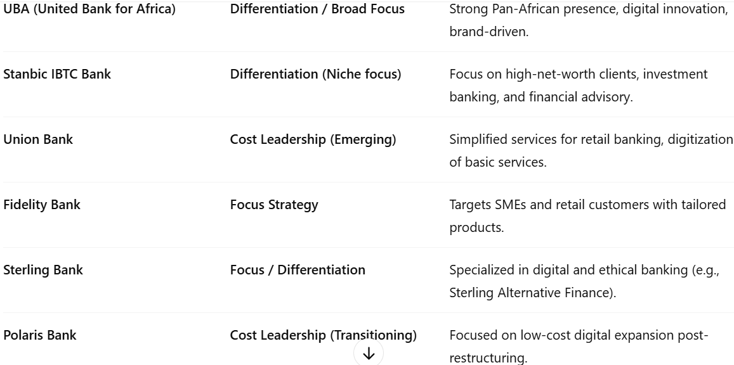
How to craft and implement effective strategies at business and corporate levels.

Slide 51
How to craft and implement effective strategies at business and corporate levels.
Crafting Business Level Strategies
Industry and Competitive Analysis: (i) Use Porter’s Five Forces to assess competition, (ii) Understand customer needs and market trends.
Choose a Competitive Positioning: (i) Cost leadership (be the lowest cost provider), (ii) Differentiation (offer unique value), (iii) Focus/Niche strategy (target a specific segment)
Define Value Proposition: Clearly articulate what makes your product/service valuable to customers.
Set SMART Goals: Specific, Measurable, Achievable, Relevant, Time-bound objectives for the business unit.

Slide 52
How to craft and implement effective strategies at business and corporate levels.
Implementing Business Level Strategies
Align Structure and Capabilities: Ensure the organisational structure, skills, and systems support the strategy.
Operationalize Plans: Break down strategies into actionable programs and projects.
Build Strategic Partnerships: Leverage suppliers, distributors, or tech alliances to enhance value delivery.
Monitor, Evaluate, Adapt: Use dashboards, customer feedback, and market data to refine the strategy.

Slide 53
How to craft and implement effective strategies at business and corporate levels.
Tips for Success
Ensure alignment between corporate and business-level strategies.
Maintain strategic agility to respond to market changes.
Foster a strategy-supportive culture across all levels.
Invest in leadership and strategic communication.

Slide 54
Tools for internal and external environmental analysis.
Internal Environmental Analysis Tools: These analyze factors within the organization.
Resource-Based View (RBV): Evaluates tangible and intangible resources and capabilities as sources of competitive advantage.
Value Chain Analysis: Examines primary and support activities to identify value-creating processes and areas of cost advantage.
VRIO Framework: Assesses resources and capabilities based on Value, Rarity, Imitability, and Organization.
Core Competence Analysis: Identifies key strengths that differentiate the organization.
Financial Ratio Analysis: Involves evaluating profitability, liquidity, and financial health using balance sheets, income statements, and cash flows

Slide 55
Tools for internal and external environmental analysis.
Example: VRIO Framework as an internal environmental analysis tool for Telecom firms in Nigeria
VALUE: Does the resource/capability provide value to customers? - The firm should identify resources and capabilities that help improve efficiency or effectiveness.
Examples: Wide network coverage across urban and rural Nigeria; High-speed data services (e.g., 4G/5G infrastructure); Strategic partnerships with fintech and streaming services; Affordable and customizable data/voice bundles.
Application: Evaluate whether these offerings meet customer needs better than competitors. Assess how these capabilities help reduce operational costs or increase revenue.

Slide 56
Tools for internal and external environmental analysis.
Example: VRIO Framework as an internal environmental analysis tool for Telecom firms in Nigeria
RARITY: Is the resource/capability rare among competitors? - A resource must be unique or uncommon to offer a competitive edge.
Examples: Exclusive licenses (e.g., spectrum licenses); Proprietary customer data analytics capabilities; Brand loyalty and market reputation; First-mover advantage in launching services (like 5G trials).
Application: Determine which assets are scarce in the Nigerian telecom industry. Understand how being rare contributes to temporary competitive advantage.

Slide 57
Tools for internal and external environmental analysis.
Example: VRIO Framework as an internal environmental analysis tool for Telecom firms in Nigeria
IMITABILITY: Is it costly or difficult to imitate? - If competitors can easily duplicate the resource or capability, it won’t provide a long-term edge.
Examples: Complex IT infrastructure and integrated platforms; Long-term agreements with global tech partners; Company culture that drives innovation; Localized customer engagement models tailored to Nigeria’s diverse regions.
Application: Assess the time, cost, or legal barriers competitors face to replicate these capabilities. Consider intellectual property protections or brand reputation as barriers to imitation.

Slide 58
Tools for internal and external environmental analysis.
Example: VRIO Framework as an internal environmental analysis tool for Telecom firms in Nigeria
ORGANIZATION: Is the firm organized to exploit these resources effectively? - Even valuable, rare, and costly-to-imitate resources are useless if the firm cannot exploit them due to poor structure or strategy.
Examples: Efficient internal structure (e.g., regional offices, agile teams); Skilled workforce and leadership; Robust customer relationship management systems; Alignment of IT, HR, and marketing toward strategic goals.
Application: Evaluate whether the firm’s management systems, processes, and culture support full utilization of its resources. Consider how quickly the firm adapts to regulatory changes from NCC or technological shifts.

Slide 59
Tools for internal and external environmental analysis.
Conclusion on the VRIO Framework as an internal environmental analysis tool for Telecom firms in Nigeria
A Nigerian telecom firm can use the VRIO framework to identify its core competencies, eliminate wasteful or non-strategic assets, and leverage strengths to gain sustainable competitive advantage. This internal audit also helps align the firm’s capabilities with external opportunities and threats for a full SWOT analysis.

Slide 60
Tools for internal and external environmental analysis.
SWOT Analysis (Internal Part): Focuses on Strengths and Weaknesses inside the organization (as opposed to Opportunities and Threats, which are external).
McKinsey 7S Framework: Assesses alignment among Strategy, Structure, Systems, Shared Values, Style, Staff, and Skills.
Organizational Culture Analysis: Examines internal beliefs, values, norms, and behavior patterns to evaluate how culture affects performance and strategy.
Benchmarking: Compares internal processes and performance metrics with best practices from other organizations or industry standards.

Slide 61
Tools for internal and external environmental analysis.
External Environmental Analysis Tools: These assess external factors that could impact the organization. Focus on the broader macro-environment and the competitive industry landscape.
PESTEL Analysis: Evaluates Political, Economic, Social, Technological, Environmental, and Legal factors.
Porter's Five Forces: Analyzes industry competitiveness and attractiveness. (i) Threat of New Entrants (ii) Bargaining Power of Suppliers (iii) Bargaining Power of Buyers (iv) Threat of Substitutes (v) Industry Rivalry
Industry Life Cycle Analysis: Identifies the stage of the industry (introduction, growth, maturity, or decline) to anticipate market trends and adjust strategies.
Competitor Analysis: Assesses strengths, weaknesses, and strategies of current and potential competitors.

Slide 62
Tools for internal and external environmental analysis.
Customer Analysis: Understands needs, preferences, and behaviors of target customers.
Scenario Planning: Develops multiple possible future scenarios to prepare strategic responses to uncertain external developments.
Market Trend Analysis: Tracks trends in consumer behavior, technological innovations, and market dynamics to identify shifts and emerging opportunities.
Stakeholder Analysis: Identifies external stakeholders (e.g., governments, NGOs, communities, media) and assesses their influence, interests, and potential impact.
SWOT Analysis (External Part): Focuses on Opportunities and Threats, which are outside the organization (as opposed to internal Strengths and Weaknesses)

Slide 63
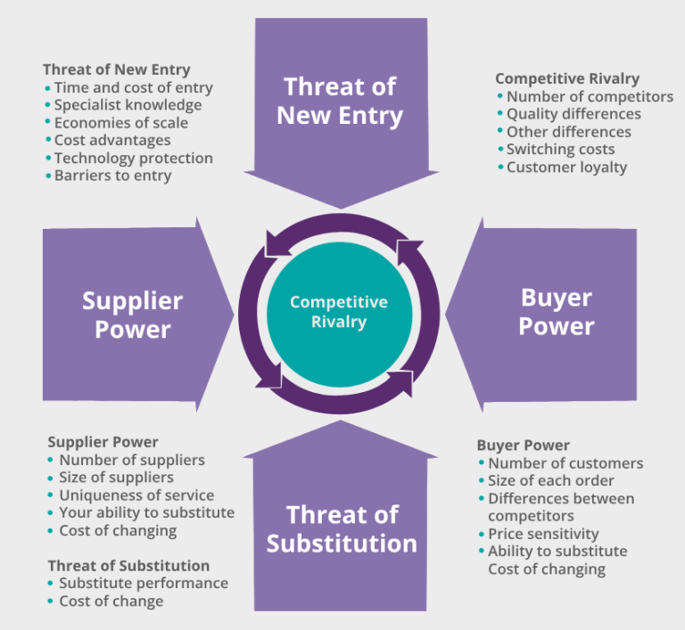
Tools for internal and external environmental analysis.
Example: Porter's Five Forces Model

Slide 64
Tools for internal and external environmental analysis.
How a consumer electronic manufacturer can use Porter's Five Forces Model
COMPETITIVE RIVALRY (INDUSTRY COMPETITION)
Analysis: This force examines how intense the competition is in the industry.
Example: A smartphone manufacturer like Tecno or Infinix faces intense competition from established brands like Samsung, Apple, and Xiaomi. These rivals compete on price, innovation, design, and features. The company must constantly innovate and offer better value to maintain market share.
Strategy: Invest in R&D and build brand loyalty to differentiate its products.

Slide 65
Tools for internal and external environmental analysis.
How a consumer electronic manufacturer can use Porter's Five Forces Model
THREAT OF NEW ENTRANTS
Analysis: Evaluates how easy or difficult it is for new competitors to enter the industry.
Example: If a startup attempts to enter the electronics manufacturing sector, it faces barriers like high capital investment for equipment and technology, brand recognition of existing players and distribution network challenges.
Strategy: A company can strengthen entry barriers by building economies of scale, securing patents for innovative technologies and locking in suppliers and distributors.

Slide 66
Tools for internal and external environmental analysis.
How a consumer electronic manufacturer can use Porter's Five Forces Model
BARGAINING POWER OF SUPPLIERS
Analysis: Determines how much power suppliers have to drive up prices.
Example: A manufacturer that relies on a few suppliers for microchips (e.g., from Taiwan Semiconductor Manufacturing Company - TSMC) may face: Increased component prices during supply shortages, and Delayed production schedules if suppliers prioritize larger clients.
Mitigation Strategy: Diversify supplier base. Invest in vertical integration (e.g., making some components in-house).Form long-term contracts with key suppliers.

Slide 67
Tools for internal and external environmental analysis.
How a consumer electronic manufacturer can use Porter's Five Forces Model
BARGAINING POWER OF BUYERS (CUSTOMERS)
Analysis: Measures the power customers have to affect pricing and terms.
Example: In the consumer electronics market, buyers have access to many alternatives and can demand lower prices, better warranties, and after-sales service, easily compare products online and switch brands.
Response Strategy: Offer product customization, build strong customer service and loyalty programs, provide value-added services (e.g., trade-in options, extended warranty).

Slide 68
Tools for internal and external environmental analysis.
How a consumer electronic manufacturer can use Porter's Five Forces Model
THREAT OF SUBSTITUTES
Analysis: Looks at the likelihood of customers switching to alternative products.
Example: Instead of buying a digital camera, a customer might use a smartphone with a high-resolution camera. This reduces demand for standalone cameras.
Strategic response: Innovate to add features smartphones don't offer (e.g., optical zoom, sensor size). Shift product lines toward emerging needs (e.g., drones with integrated cameras). Focus on niche markets like professional photography.

Slide 69
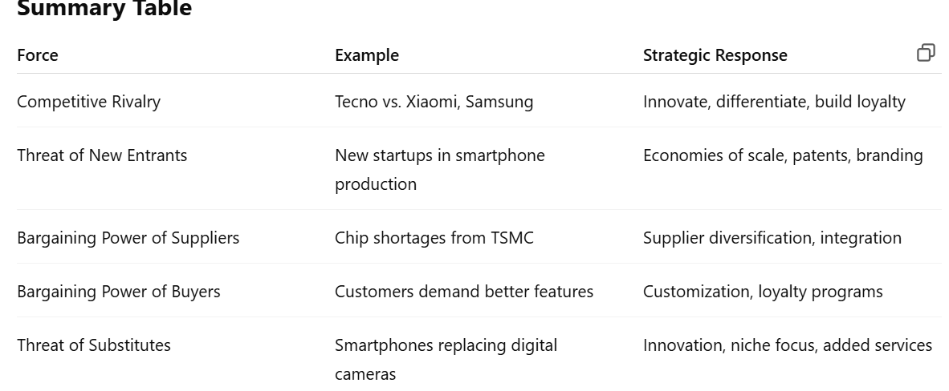
Tools for internal and external environmental analysis.
How a consumer electronic manufacturer can use Porter's Five Forces Model

Slide 70
Techniques to align organizational capabilities with strategic objectives.
Aligning organizational capabilities with strategic objectives is crucial for achieving sustainable success. Here are key techniques to achieve that alignment:
1. Strategic Planning and Capability Mapping: Conduct a strategic capability analysis to identify the key competencies required to execute your strategy.
Map current capabilities against the strategic goals to identify gaps or redundancies.
2. Balanced Scorecard (BSC): Use the Balanced Scorecard to translate strategic objectives into measurable goals across key perspectives (financial, customer, internal processes, learning & growth).
Align departmental goals and individual KPIs with these strategic targets.

Slide 71
Techniques to align organizational capabilities with strategic objectives.
3. Resource Allocation and Investment Prioritization
Allocate resources (financial, human, technological) based on strategic priorities.
Invest in building or acquiring capabilities that are missing but critical for strategy execution.
4. Organizational Structure Optimization
Restructure departments or teams to better support strategic goals.
Create cross-functional teams to enhance collaboration and agility.

Slide 72
Techniques to align organizational capabilities with strategic objectives.
5. Leadership Alignment and Communication
Ensure leaders at all levels understand and are committed to the strategy.
Use cascading goals to align leadership and employee performance objectives.
6. Change Management
Implement structured change management practices to support transformation efforts.
Address resistance and engage employees through communication, training, and participation.
7. Talent Management and Development
Recruit, train, and retain talent with the skills aligned to strategic needs.
Create learning and development programs to build critical capabilities.

Slide 73
Techniques to align organizational capabilities with strategic objectives.
8. Performance Management Systems
Align appraisal and reward systems with strategic objectives.
Use regular performance reviews to ensure continuous alignment and accountability.
9. Continuous Improvement and Feedback Loops
Establish feedback mechanisms (like employee surveys, performance dashboards) to monitor alignment.
Adapt strategies and capabilities based on performance data and environmental changes.

Slide 74
The role of leadership and culture in strategy execution.
Leadership is the ability to influence, guide, and inspire others toward the achievement of a common goal or vision.
Transformational Leadership – Inspires change and innovation.
Transactional Leadership – Focuses on structure, rewards, and performance.
Servant Leadership – Prioritizes the growth and well-being of team members.
Democratic Leadership – Involves others in decision-making.
Autocratic Leadership – Centralized decision-making with strict control.
Laissez-faire leadership - (from the French phrase meaning "let do" or "let them do"). Leaders provide minimal direction and allow team members to make decisions and manage their own work.

Slide 75
The role of leadership and culture in strategy execution.
The Role of Leadership in Strategy Execution: critical enabler - or barrier - to successful strategy execution. Leadership plays the following roles in strategy execution.
Vision Communication:
Leaders articulate the strategic vision clearly and consistently to all levels of the organization.
They help employees understand why the strategy matters and how they contribute to it.
Alignment and Motivation:
Ensure alignment between individual, team, and departmental goals with strategic objectives.
Inspire and motivate teams by connecting strategy to values, purpose, and rewards.

Slide 76
The role of leadership and culture in strategy execution.
Resource Allocation:
Leaders prioritize and allocate resources (people, time, capital) to initiatives that drive strategic outcomes.
Change Leadership:
They champion and lead through organizational change, removing obstacles and managing resistance.
Provide visible support for new strategic initiatives to build momentum.
Accountability and Performance Monitoring:
Establish a performance culture through regular tracking, feedback, and adjustments.
Hold themselves and others accountable for results.

Slide 77
The role of leadership and culture in strategy execution.
Organizational culture refers to the shared values, beliefs, attitudes, and norms that shape how people behave and interact within an organization.
Organizational culture is the pattern of shared basic assumptions learned by a group as it solved its problems of external adaptation and internal integration, which has worked well enough to be considered valid and, therefore, to be taught to new members as the correct way to perceive, think, and feel."— Schein, E. H. (2010).

Slide 78
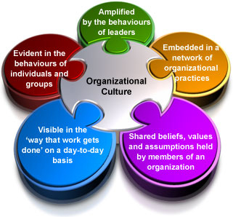
The role of leadership and culture in strategy execution.

Slide 79
The role of leadership and culture in strategy execution.
Key Aspects of Organizational Culture:
Values – Core principles that guide decisions and actions (e.g., integrity, innovation, teamwork).
Beliefs – Common understandings about what is important or expected.
Norms – Unwritten rules about how people should behave.
Symbols and Rituals – Logos, dress codes, ceremonies, and traditions that express the culture.
Language and Communication Style – How people talk, the tone used, and shared jargon.

Slide 80
The role of leadership and culture in strategy execution.
The Role of Culture in Strategy Execution: critical enabler - or barrier - to successful strategy execution. Culture plays the following roles in strategy execution.
Behavioral Reinforcement
Culture determines how people behave—whether they innovate, collaborate, or take ownership—which directly affects execution.
A culture that supports agility, discipline, and customer focus enhances strategic implementation.
Decision-Making and Risk-Tolerance
Cultural norms shape how decisions are made and how much risk the organization tolerates.
In a risk-averse culture, bold strategies may fail to take off; in a trust-based culture, execution is faster and more decisive.

Slide 81
The role of leadership and culture in strategy execution.
Employee Engagement
When the culture aligns with the strategy, employees are more engaged and committed.
A strong, positive culture fosters a sense of belonging and purpose.
Speed of Execution
A culture of accountability and urgency accelerates execution, while bureaucratic or toxic cultures slow it down.
Conclusion: Without supportive leadership and culture, even the best strategy will fail in execution. Effective leaders shape culture and lead by example to turn strategy into action.

Slide 82
Methods for monitoring and controlling strategic initiatives.
Monitoring and controlling strategic initiatives is essential to ensure that an organization stays aligned with its strategic goals and adjusts to changes in internal and external environments. Here are key methods used to monitor and control such initiatives:
1. Key Performance Indicators (KPIs)
Set measurable metrics aligned with strategic objectives.
Regularly track performance through dashboards or scorecards.
Example: Revenue growth, market share, customer satisfaction.
2. Balanced Scorecard
Provides a comprehensive view by evaluating performance across four perspectives: Financial, Customer, Internal processes, Learning and growth
Links strategy to performance metrics.

Slide 83
Methods for monitoring and controlling strategic initiatives.
3. Milestone Tracking and Gantt Charts
Break down initiatives into phases with timelines.
Monitor progress against planned milestones.
Use tools like Microsoft Project or Trello.
4. Strategic Reviews and Progress Meetings
Periodic review sessions with key stakeholders.
Identify bottlenecks, reassess priorities, and make data-driven decisions.

Slide 84
Methods for monitoring and controlling strategic initiatives.
5. Risk Management Systems
Identify potential risks to strategic initiatives.
Continuously assess and update risk mitigation plans.
Use risk registers or heat maps.
6. Change Management Processes
Monitor organizational readiness and response to strategic changes.
Use tools like stakeholder analysis, communication plans, and feedback loops.
7. Performance Audits and Benchmarking
Conduct internal or external audits to evaluate effectiveness.
Compare results against industry best practices or competitors.

Slide 85
Methods for monitoring and controlling strategic initiatives.
8. Project and Portfolio Management (PPM) Tools
Software platforms like Asana, Jira, or Smartsheet help manage multiple strategic projects.
Enable real-time reporting and resource allocation.
9. Budgetary Controls and Financial Analysis
Monitor expenditures vs. budgeted amounts.
Analyze cost-benefit ratios and ROI on strategic initiatives.
10. Dashboards and Real-Time Analytics
Visual, data-driven tools that provide real-time insights into initiative status.
Support faster, informed decision-making.

Slide 86
Methods for monitoring and controlling strategic initiatives.
Example: Balanced Scorecard of a private secondary school for monitoring and controlling strategic initiatives.
The BSC is structured around the four standard perspectives: Financial, Customer (Students & Parents), Internal Processes, and Learning & Growth.
Here is a sample Balanced Scorecard (BSC) tailored for a private secondary school to effectively monitor and control its strategic initiatives.

Slide 87
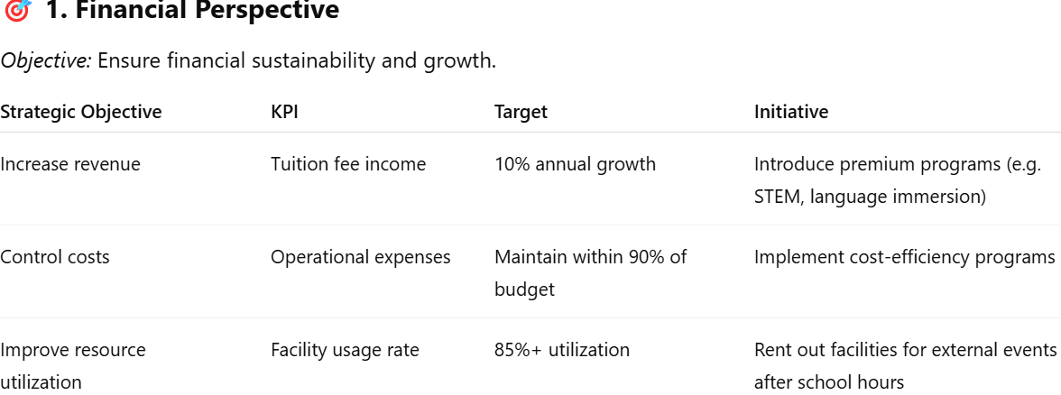
Methods for monitoring and controlling strategic initiatives.

Slide 88
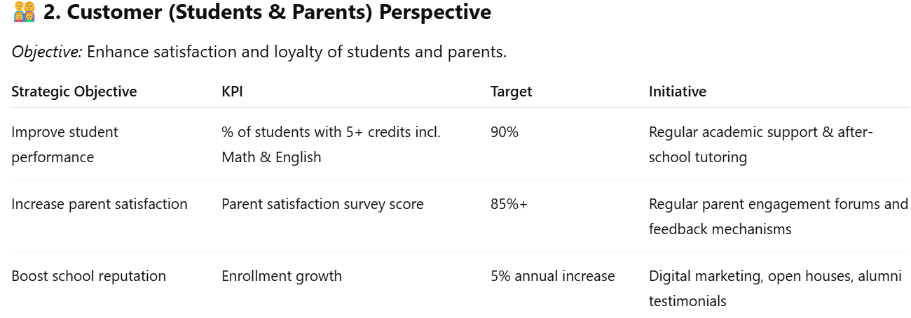
Methods for monitoring and controlling strategic initiatives.

Slide 89
Methods for monitoring and controlling strategic initiatives.

Slide 90
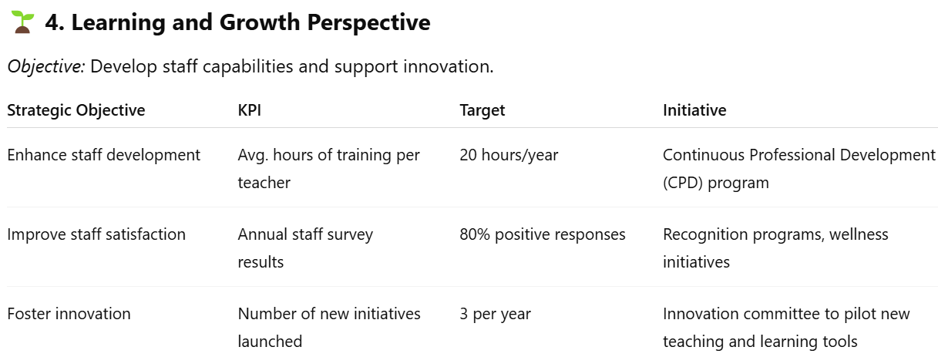
Methods for monitoring and controlling strategic initiatives.

Slide 91
theories of strategic management
Theories of strategic management provide frameworks and perspectives that help organizations understand how to formulate, implement, and evaluate strategies to achieve competitive advantage. Below are the major theories of strategic management:
1. Classical (or Planning) Theory
Key idea: Strategy is a rational, deliberate process of planning by top management.
Proponents: Igor Ansoff, Michael Porter.Example concepts: SWOT analysis, Porter's Five Forces, Value Chain Analysis.
Assumptions: Predictable environment, rational decision-makers

Slide 92
theories of strategic management
2. Evolutionary Theory
Key idea: Strategy emerges through a process of natural selection in a competitive environment.
Proponents: Michael Hannan, Freeman, Nelson & Winter.
Analogy: Survival of the fittest — firms with best strategies survive.
Assumptions: Market forces determine winners; managers have limited control.

Slide 93
theories of strategic management
3. Processual Theory
Key idea: Strategy emerges from internal processes, politics, and organizational culture.
Proponents: Henry Mintzberg, Richard Whittington.
Features: Emphasizes incrementalism, learning, and bounded rationality.
Assumptions: Organizations are messy; strategy evolves through practice and learning.

Slide 94
theories of strategic management
4. Systemic Theory
Key idea: Strategy is shaped by the social systems and institutions within which the firm operates.
Proponents: Richard Whittington.
Focus: Cultural, political, and institutional context.
Assumptions: Strategic behavior varies across different societies and institutional settings.

Slide 95
theories of strategic management
5. Resource-Based View (RBV)
Key idea: Competitive advantage stems from unique internal resources and capabilities.
Proponents: Jay Barney, Edith Penrose.
Core concept: VRIO framework (Valuable, Rare, Inimitable, Organized).
Assumptions: Internal resources are more important than external positioning.

Slide 96
theories of strategic management
6. Dynamic Capabilities Theory
Key idea: Firms must adapt, integrate, and reconfigure internal and external competencies to address rapidly changing environments.
Proponents: David Teece, Gary Pisano.
Focus: Learning, innovation, and responsiveness.
Relation to RBV: Builds on RBV but adds adaptability to change.

Slide 97
theories of strategic management
6. Dynamic Capabilities Theory
Key idea: Firms must adapt, integrate, and reconfigure internal and external competencies to address rapidly changing environments.
Proponents: David Teece, Gary Pisano.
Focus: Learning, innovation, and responsiveness.
Relation to RBV: Builds on RBV but adds adaptability to change.

Slide 98
theories of strategic management
7. Stakeholder Theory
Key idea: Strategy should consider the interests of all stakeholders, not just shareholders.
Proponents: R. Edward Freeman.
Focus: Ethical management, corporate social responsibility.
Assumptions: Long-term success depends on managing stakeholder relationships.

Slide 99
recommendations to managers on translating theory to practice in the area of Strategic Management
Translating theory into practice in Strategic Management can be challenging but crucial for organizational success. Here are key recommendations for managers seeking to bridge the gap:
1. Understand the Context Before Applying Theory
Tailor strategies to your organization's industry, size, culture, and stage of growth.
Avoid “one-size-fits-all” applications; instead, adapt models like SWOT, PESTEL, or Porter’s Five Forces to fit real-world dynamics.

Slide 100
recommendations to managers on translating theory to practice in the area of Strategic Management
2. Use Strategic Frameworks as Guides, Not Rules
Treat tools such as the Balanced Scorecard or Ansoff Matrix as starting points for dialogue and decision-making, not rigid formulas.
Encourage creativity and flexibility in applying these tools to evolving situations.
3. Align Strategy with Execution
Ensure strategic objectives are broken down into clear, actionable goals across departments.
Use tools like OKRs (Objectives and Key Results) or KPIs to track progress and maintain focus.

Slide 101
recommendations to managers on translating theory to practice in the area of Strategic Management
4. Foster Strategic Thinking at All Levels
Train employees and mid-level managers to think strategically, not just operationally.
Create a culture where long-term thinking is integrated into daily operations.
5. Encourage Cross-Functional Collaboration
Implement strategy with input and ownership from finance, HR, marketing, and operations to avoid siloed thinking.
Promote interdisciplinary teams to drive initiatives that align with strategic goals.

Slide 102
recommendations to managers on translating theory to practice in the area of Strategic Management
6. Invest in Continuous Learning and Development
Provide regular training in strategy formulation and implementation.
Encourage attendance at industry workshops and use case studies to illustrate best practices.
7. Monitor, Evaluate, and Adjust
Strategic plans must be dynamic; use real-time data to evaluate effectiveness.
Create feedback loops to revise strategies based on internal performance and external shifts.

Slide 103
recommendations to managers on translating theory to practice in the area of Strategic Management
8. Lead by Example
Senior leadership should model strategic behaviors—vision setting, critical thinking, and long-term orientation.
Inspire commitment through visible, consistent engagement with strategic initiatives.
9. Communicate Strategy Clearly and Repeatedly
Ensure everyone understands the "why" behind strategic choices.
Use storytelling, visuals, and town halls to make abstract concepts tangible.
10. Align Incentives with Strategic Goals
Tie performance bonuses, promotions, and recognition to strategic contributions, not just routine tasks.

Slide 104
THANK
YOU
90

